Slide 1
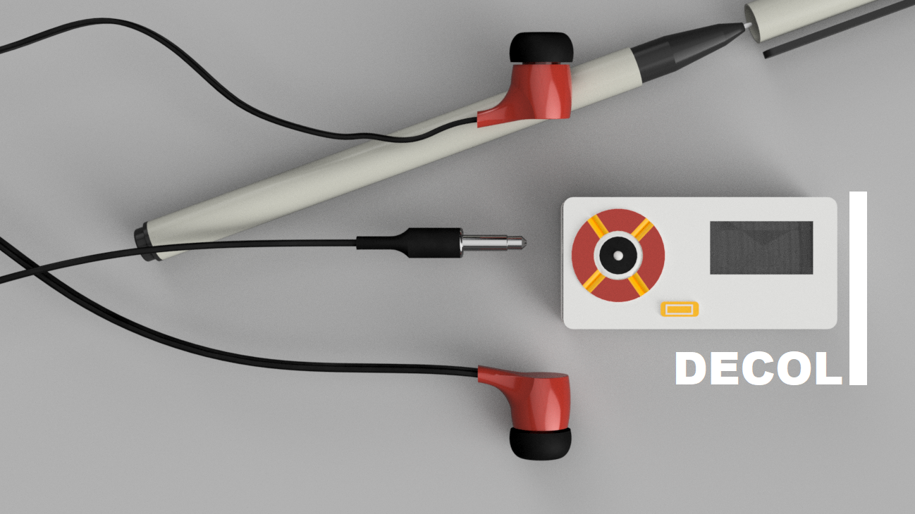

“REQUIRE A POCKET SIZED SDR ,WHICH IS FULLY AUTOMATIC , CAN CONNECT TO THE INTERNET AND DO MORE” ~ problem statement
A Compact Portable SDR
Author:
Suryasaradhi

Slide 2
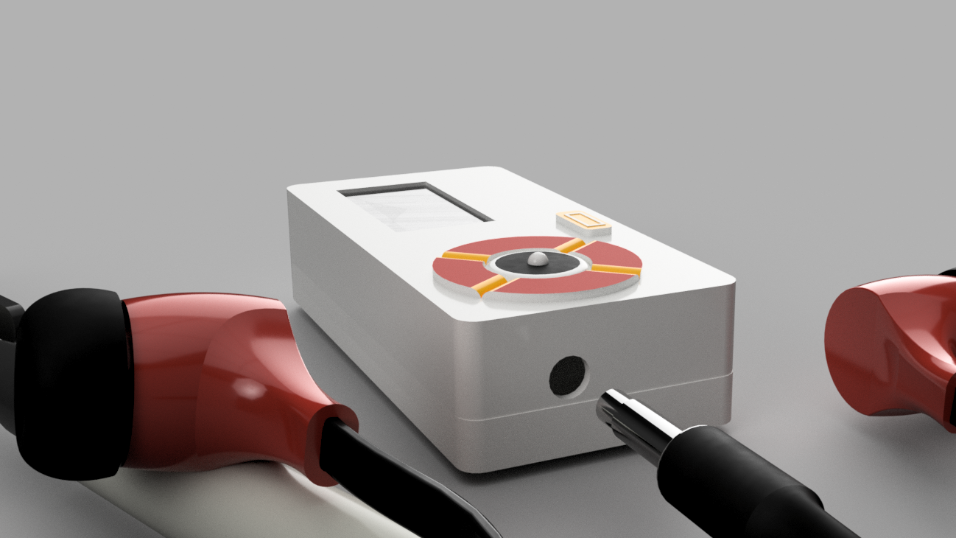
Problem Statement and Solution
Problem Statement | Current State
SDR Capable of Eavesdropping | We created an SDR capable of Eavesdropping from 500khz – 1700Mhz
AI Automatic Demodulator | Implemented using SVM
Less power | 3hrs Battery backup
Auto translate Detected Speech | Implemented using GCP
Decouple RX from TX | Planning for Implementation of filter based crystals

Slide 3
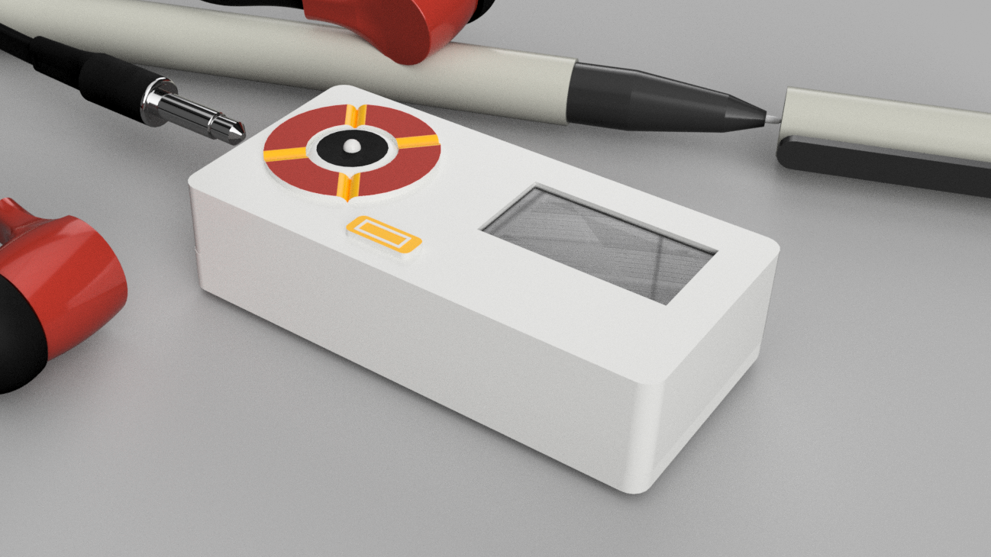
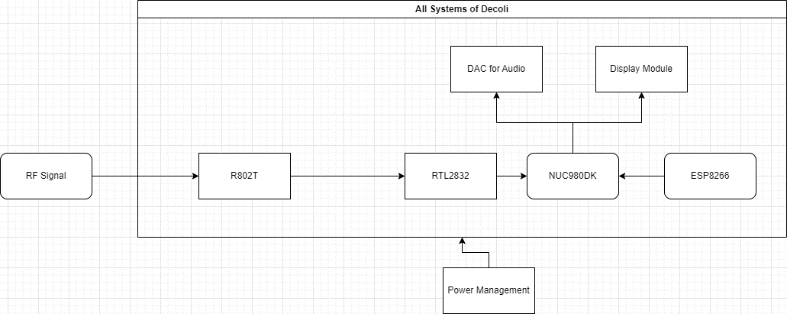
Architecture and Technical Details
Tuner Chip
DSP
Microprocessor
Architecture of DECOLI
Wifi Chip
Software/Kernel : Python, C
Technologies Used: GCP, Pyrtlsdr, Nu-Openwrt, UHRP, GUISlice, Tensorflow for MCU

Slide 4
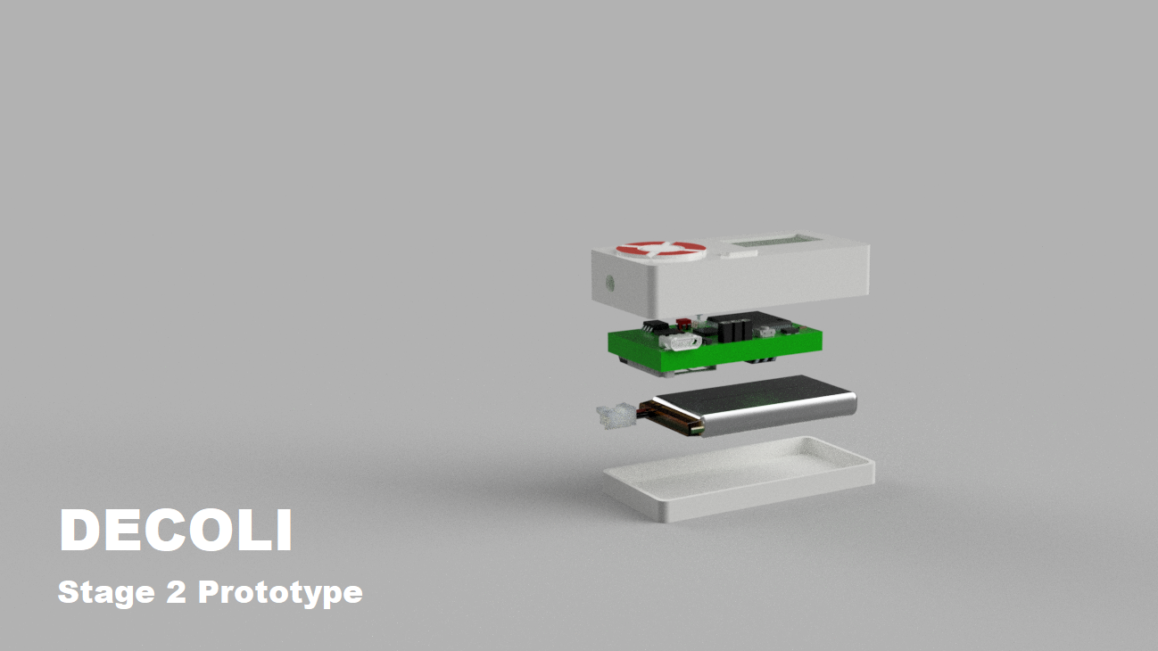
Specifications
Form Factor of Motherboard | Medium [57mm x 27mm x 10mm]
Copyright infringement | NONE
Inter-Connections | All On Single board
Hardware Technologies | Wi-Fi - 2.5G – Onboard Antenna HF Direct Sampling Mode <1 PPM temperature compensated oscillator (TCXO) Embedded Display and Navigation Controls Battery Life up to 3 Hours Oled Display 3.7V Bias Tee Switchable Boot Configuration (USB/SD Card) Dedicated 24-bit Audio Chip for best quality.
RF Technologies | Full RF Spectrum Sweep Demod RF Transmissions Save/Play Transmissions
AI Technologies | Detection and Demod of Signals Translation using GCP
Frequency Sweep | 500Khz – 1766 MHz (BW: 3.2Mhz) (I have left Space for adding a downconverter for increasing frequency)

Slide 5
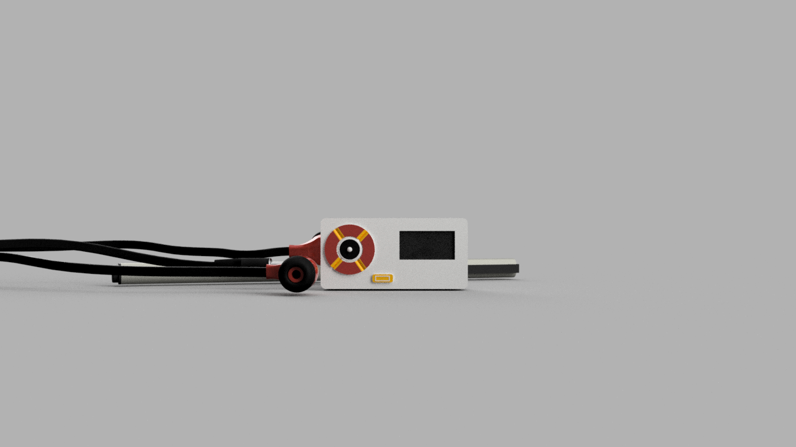
Future Plans and Conclusion
Implement downconverter and a LNA for extending frequency range
Software switchable boot mode
Decrease size and Increase battery lifetime by replacing LDO’s with buck converters
PCB Impedance matching (Recheck)
Implement Complete GCP translation services
Implement Complete GUI
Implement Buck switching converters for stepping up 3.7v to 5V for smoother operation of Nuvoton processor.
LC filters for power supply ripple filters.
Charge level indicator based on current flow.
Write modular Software classes

